Slide 1
Meta Learning (Part 2): Gradient Descent as LSTM
Hung-yi Lee
Notes:
\theta \phi 應該要用不同的顏色
Agnostic不可知論的
Very good tutorial !!!!!
Good summarization: https://lilianweng.github.io/lil-log/2018/11/30/meta-learning.html

Slide 2
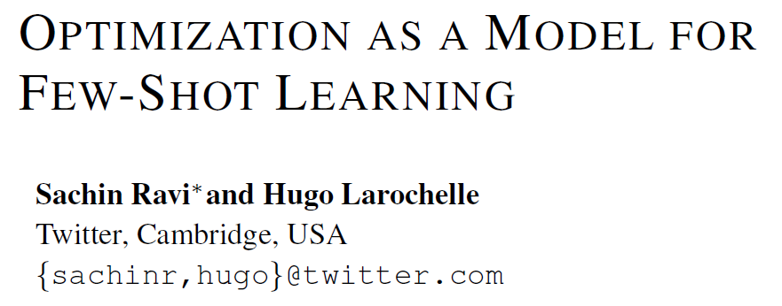
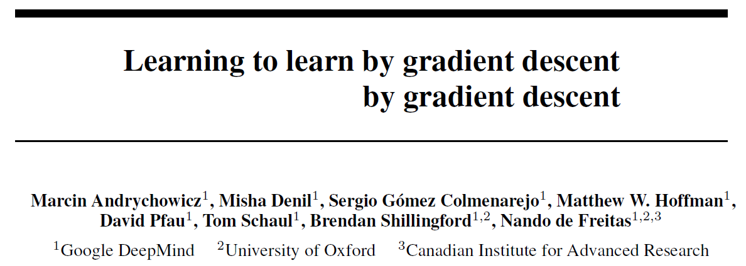





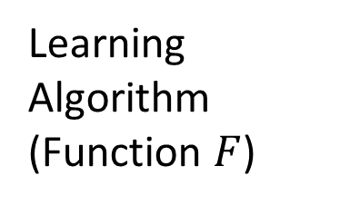


Can we learn more than initialization parameters?
$$\hat{θ}$$
Network
Structure
$$φ$$
Update
Update
$$θ^{0}$$
$$θ^{1}$$
$$θ^{2}$$
Init
$$∇l$$
$$∇l$$
Learning Algorithm
(Function $F$)
Compute Gradient
Compute Gradient
The learning algorithm looks like RNN.
Training
Data
Training
Data

Slide 3

Recurrent Neural Network
h and h’ are vectors with the same dimension
Given function f: $h^{′},y=f\left(h,x\right)$
y¹
y²
y³
h⁰
f
h¹
f
h²
f
h³
……
x¹
x²
x³
No matter how long the input/output sequence is, we only need one function f

Slide 4
LSTM
y^{t}
LSTM
c^{t}
y^{t}
c^{t-1}
Naïve
RNN
h^{t}
h^{t}
h^{t-1}
h^{t-1}
x^{t}
x^{t}
c change slowly
c^{t} is c^{t-1} added by something
h change faster
h^{t} and h^{t-1} can be very different

Slide 5




Review: LSTM
x^{t}
z
W
$$=tanh\left( \right)$$
h^{t-1}
c^{t-1}
x^{t}
z^{i}
W^{i}
$$=σ\left( \right)$$
h^{t-1}
input
x^{t}
z^{f}
W^{f}
$$=σ\left( \right)$$
h^{t-1}
z^{f}
z^{i}
z
zº
forget
x^{t}
zº
Wº
$$=σ\left( \right)$$
h^{t-1}
x^{t}
h^{t-1}
output
Notes:
Identiy
C is vector

Slide 6








Review: LSTM
y^{t}
c^{t-1}
c^{t}
$$⨀$$
$$＋$$
$$⨀$$
tanh
$$c^{t}=z^{f}⨀c^{t−1}$$
$$+z^{i}⨀z$$
$$⨀$$
$$h^{t}=z^{o}⨀tanh\left(c^{t}\right)$$
z^{f}
z^{i}
z
zº
$$y^{t}=σ\left(W^{′}h^{t}\right)$$
h^{t-1}
x^{t}
h^{t}
Notes:
Identiy
C is vector

Slide 7








Review: LSTM
y^{t}
y^{t+1}
c^{t-1}
c^{t}
c^{t+1}
$$⨀$$
$$＋$$
$$⨀$$
$$⨀$$
$$＋$$
$$⨀$$
tanh
tanh
$$⨀$$
$$⨀$$
z^{f}
z^{i}
z
zº
z^{f}
z^{i}
z
zº
h^{t}
h^{t-1}
x^{t}
h^{t}
x^{t+1}
Notes:
https://arxiv.org/pdf/1412.3555.pdf
Identiy
C is vector

Slide 8










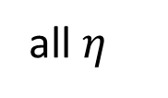
Similar to gradient descent based algorithm
$$θ^{t}=θ^{t−1}−η∇_{θ}l$$
y^{t}
$$\left[\begin{aligned}1 \\ 1 \\ ⋮\end{aligned}\right]$$
$$\left[\begin{aligned}η \\ η \\ ⋮\end{aligned}\right]$$
c^{t-1}
c^{t}
$$θ^{t−1}$$
$$θ^{t}$$
$$⨀$$
$$＋$$
$$⨀$$
tanh
$$c^{t}=z^{f}⨀c^{t−1}$$
$$+z^{i}⨀z$$
$$−∇_{θ}l$$
$$θ^{t}$$
$$θ^{t−1}$$
$$⨀$$
all “1”
all $η$
$$h^{t}=z^{o}⨀tanh\left(c^{t}\right)$$
z^{f}
z^{i}
z
zº
$$−∇_{θ}l$$
$$y^{t}=σ\left(W^{′}h^{t}\right)$$
h^{t-1}
x^{t}
h^{t}
$$−∇_{θ}l$$
Notes:
Identiy
C is vector

Slide 9
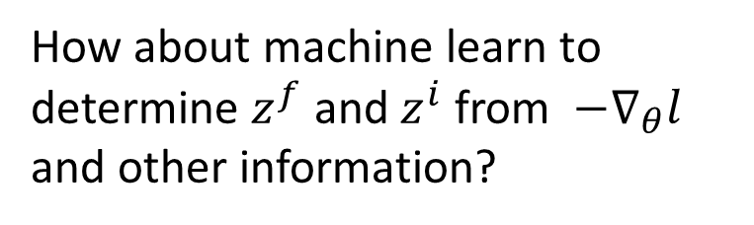
Similar to gradient descent based algorithm
$$θ^{t}=θ^{t−1}−η∇_{θ}l$$
Something like regularization
c^{t-1}
c^{t}
$$θ^{t−1}$$
$$θ^{t}$$
$$⨀$$
$$＋$$
$$c^{t}=z^{f}⨀c^{t−1}$$
$$+z^{i}⨀z$$
$$−∇_{θ}l$$
$$θ^{t}$$
$$θ^{t−1}$$
$$⨀$$
all “1”
all $η$
Dynamic learning rate
z^{f}
z^{i}
z
$$−∇_{θ}l$$
How about machine learn to determine $z^{f}$ and $z^{i}$ from $−∇_{θ}l$ and other information?
Other
h^{t-1}
x^{t}
$$−∇_{θ}l$$
Notes:
Identiy
C is vector

Slide 10
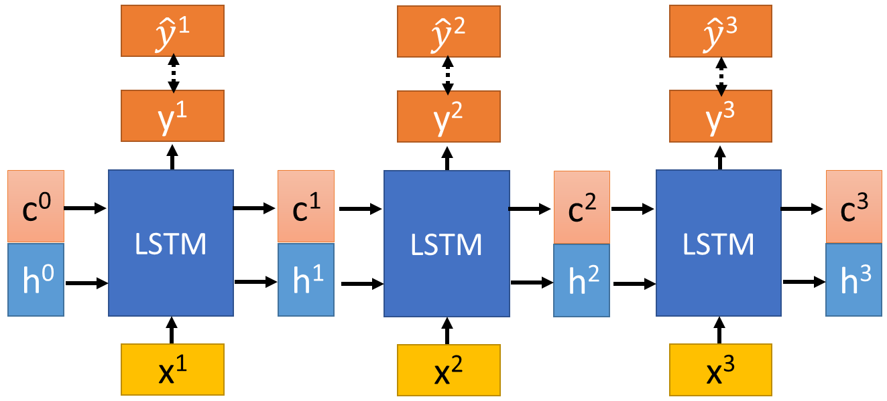













Typical LSTM
LSTM for Gradient Descent
$$c^{t}=z^{f}⨀c^{t−1}$$
$$+z^{i}⨀z$$
$$−∇_{θ}l$$
$$θ^{t}$$
$$θ^{t−1}$$
Learn to minimize
3 training steps
Testing Data
$$l\left(θ^{3}\right)$$
Learnable
“LSTM”
“LSTM”
“LSTM”
$$θ^{0}$$
$$θ^{1}$$
$$θ^{2}$$
$$θ^{3}$$
$$−∇_{θ}l$$
$$−∇_{θ}l$$
$$−∇_{θ}l$$
Independence assumption
Batch from train
Batch from train
Batch from train

Slide 11














Real Implementation
The LSTM used only has one cell. Share across all parameters
“LSTM”
“LSTM”
“LSTM”
$$θ_{1}^{0}$$
$$θ_{1}^{1}$$
$$θ_{1}^{2}$$
$$θ_{1}^{3}$$
$$−∇_{θ_{1}}l$$
$$−∇_{θ_{1}}l$$
$$−∇_{θ_{1}}l$$
“LSTM”
“LSTM”
“LSTM”
$$θ_{2}^{0}$$
$$θ_{2}^{1}$$
$$θ_{2}^{2}$$
$$θ_{2}^{3}$$
$$−∇_{θ_{2}}l$$
$$−∇_{θ_{2}}l$$
$$−∇_{θ_{2}}l$$
Reasonable model size
In typical gradient descent, all the parameters use the same update rule
Training and testing model architectures can be different.

Slide 12
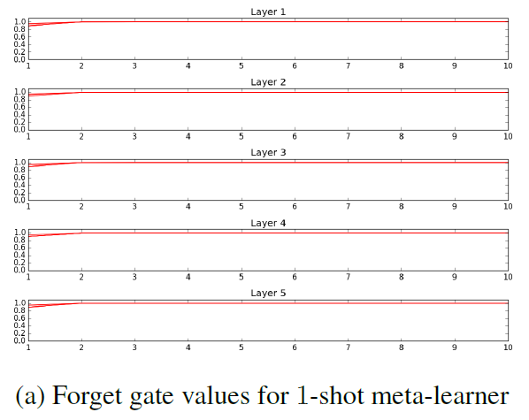
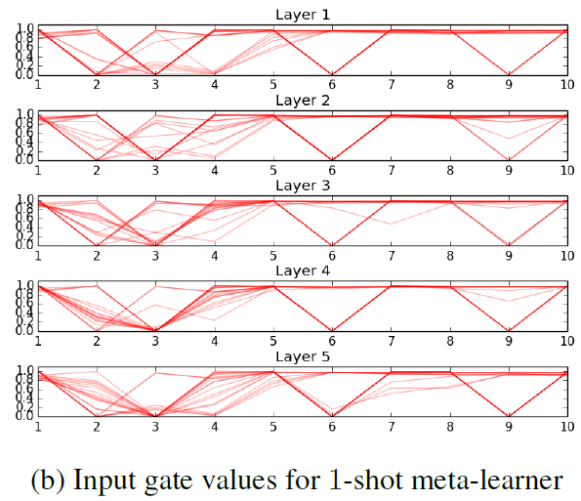


Experimental Results
https://openreview.net/forum?id=rJY0-Kcll&noteId=ryq49XyLg
$$c^{t}=z^{f}⨀c^{t−1}$$
$$+z^{i}⨀z$$
$$−∇_{θ}l$$
$$θ^{t}$$
$$θ^{t−1}$$

Slide 13
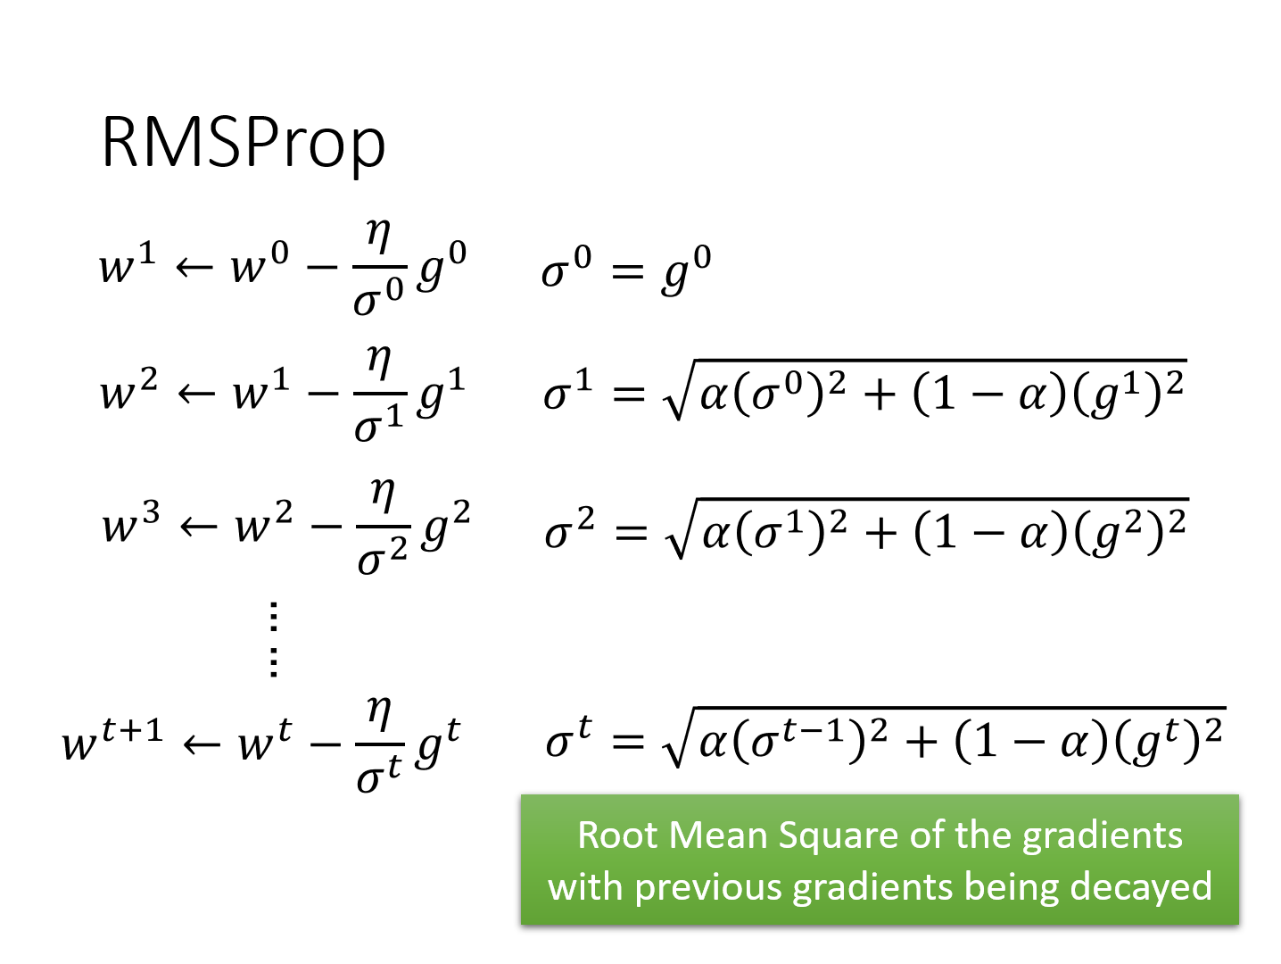
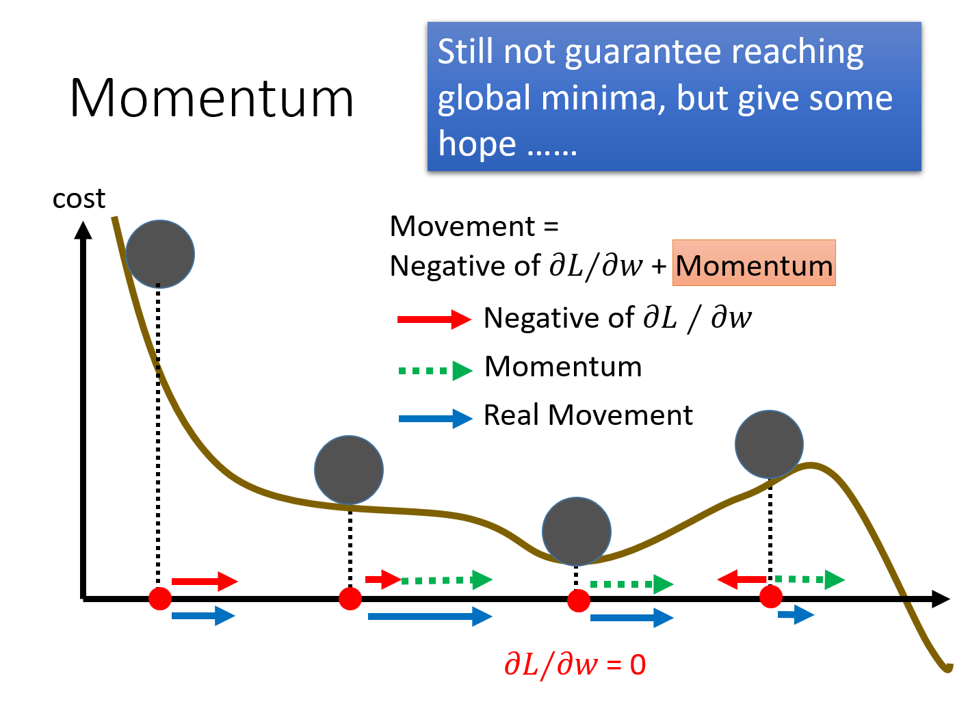
Parameter update depends on not only current gradient, but previous gradients.

Slide 14











LSTM for Gradient Descent (v2)
3 training steps
m can store previous gradients
Testing Data
$$l\left(θ^{3}\right)$$
“LSTM”
“LSTM”
“LSTM”
$$θ^{0}$$
$$θ^{1}$$
$$θ^{2}$$
$$θ^{3}$$
“LSTM”
“LSTM”
“LSTM”
$$m^{0}$$
$$m^{1}$$
$$m^{2}$$
$$−∇_{θ}l$$
$$−∇_{θ}l$$
$$−∇_{θ}l$$
Batch from train
Batch from train
Batch from train

Slide 15
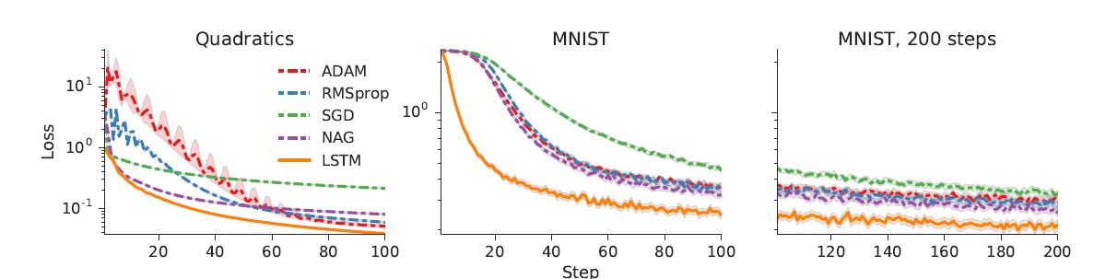
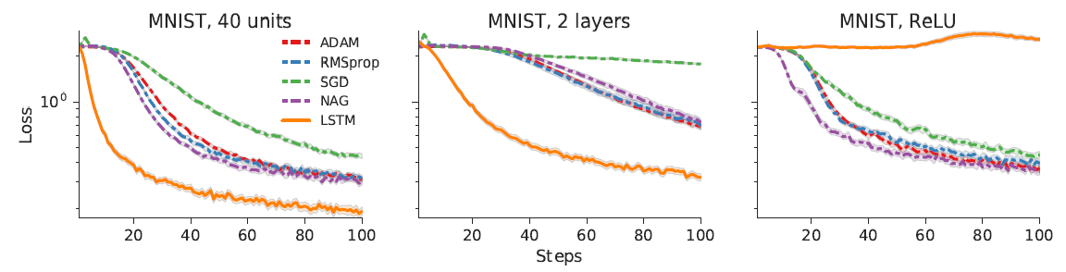
Experimental Results
https://arxiv.org/abs/1606.04474

Slide 16
Meta Learning (Part 3)
Hung-yi Lee
Notes:
Any progress in architecture search
KeLi’s blog is good: https://bair.berkeley.edu/blog/2017/09/12/learning-to-optimize-with-rl/
\theta \phi 應該要用不同的顏色
Agnostic不可知論的
Very good tutorial !!!!!
Good summarization: https://lilianweng.github.io/lil-log/2018/11/30/meta-learning.html

Slide 17

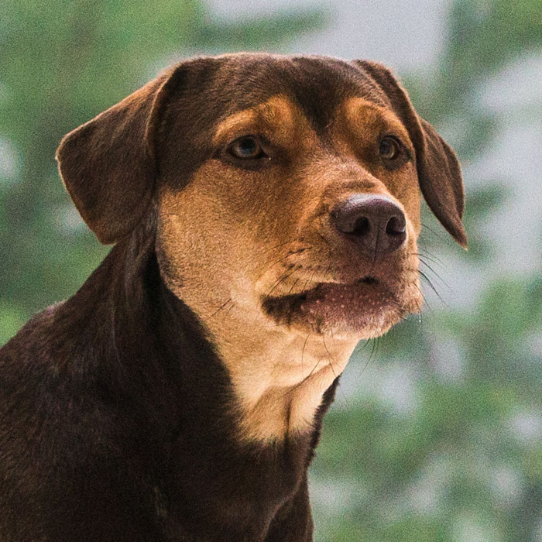
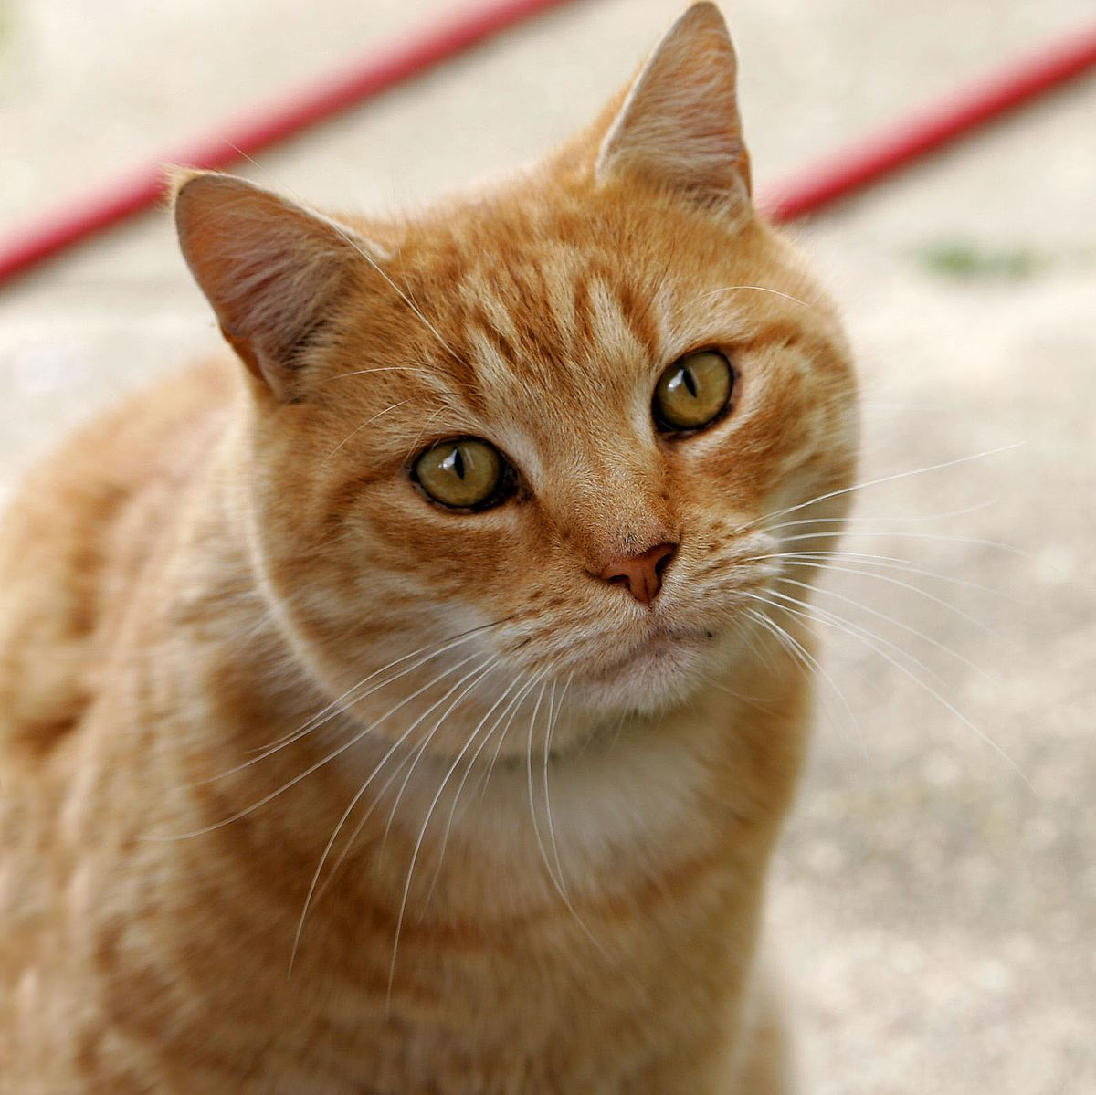
Even more crazy idea …
Input:
Training data and their labels
Testing data
Output:
Predicted label of testing data
cat
Learning + Prediction
cat
dog
Training Data & Labels
Testing Data

Slide 18
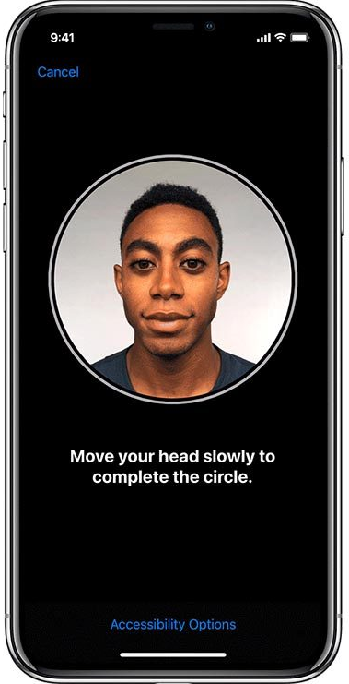
Face Verification
In each task:
Few-shot Learning
Registration (Collecting Training data)
Testing
Unlock your phone by Face
Training
https://support.apple.com/zh-tw/HT208109

Slide 19








Meta Learning
Same approach for
Speaker Verification
Yes
Network
Train
Test
Yes
No
Training
Tasks
Train
Test
No
Network
Train
Test
No
?
Network
Testing
Tasks
Yes
or
No
Train
Test
Notes:
第十四王子_瓦布爾

Slide 20
Siamese Network
No
Network
CNN
embedding
Train
Same
share
Similarity
score
CNN
Yes
Large score
embedding
Small score
No
Test
Notes:
中文译作暹罗。Siamese也就是“暹罗”人或“泰国”人。Siamese在英语中是“孪生”、“连体”的意思，这是为什么呢
https://zhuanlan.zhihu.com/p/35040994？

Slide 21
Siamese Network
No
Network
CNN
embedding
Train
Different
share
Similarity
score
CNN
Yes
Large score
embedding
Small score
No
Test
Notes:
中文译作暹罗。Siamese也就是“暹罗”人或“泰国”人。Siamese在英语中是“孪生”、“连体”的意思，这是为什么呢？

Slide 22
Siamese Network - Intuitive Explanation
Binary classification problem: “Are they the same?”
same
Same or Different
Training
Set
different
Network
different
Face
1
Face
2
Testing
Set
?

Slide 23
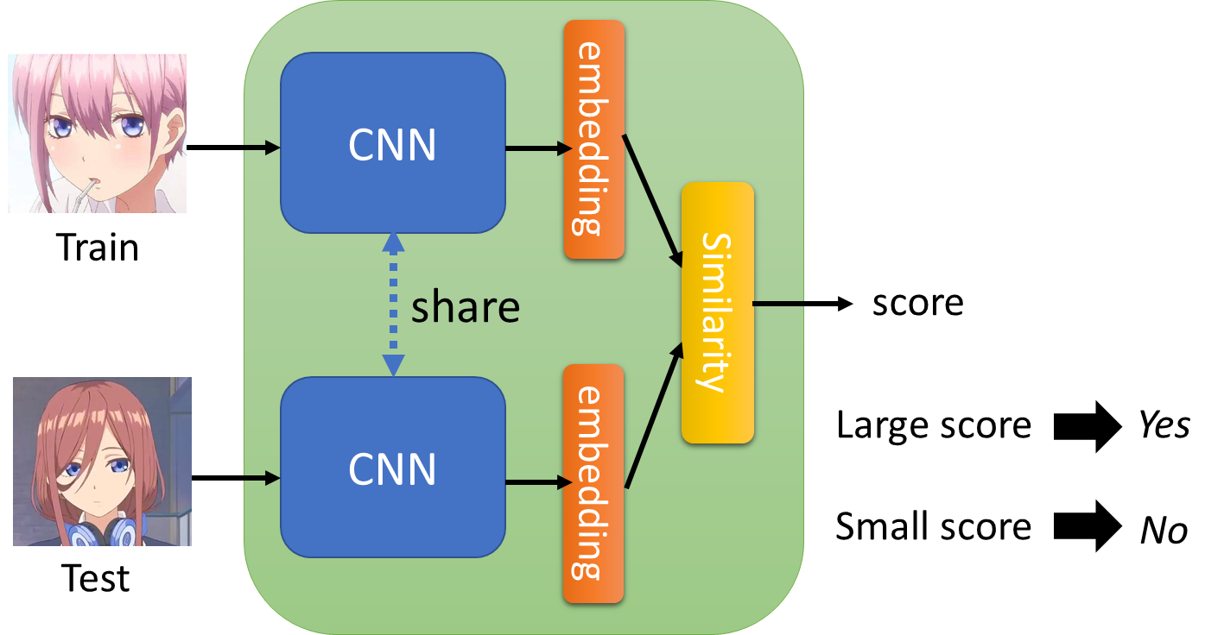
Siamese Network - Intuitive Explanation
Learning embedding for faces
Far away
CNN
e.g. learn to ignore the background
As close as possible
CNN
CNN
Notes:
其實應該要講一下怎麼算 distance

Slide 24
To learn more …
What kind of distance should we use?
SphereFace: Deep Hypersphere Embedding for Face Recognition
Additive Margin Softmax for Face Verification
ArcFace: Additive Angular Margin Loss for Deep Face Recognition
Triplet loss
Deep Metric Learning using Triplet Network
FaceNet: A Unified Embedding for Face Recognition and Clustering

Slide 25



N-way Few/One-shot Learning
Example: 5-ways 1-shot
三玖
Network (Learning + Prediction)
一花
二乃
三玖
四葉
五月
Testing
Data
Training Data (Each image represents a class)
Notes:
Oriol Vinyals, Charles Blundell, Timothy Lillicrap, Koray Kavukcuoglu, Daan Wierstra, “Matching Networks for One Shot Learning”, NIPS, 2016

Slide 26
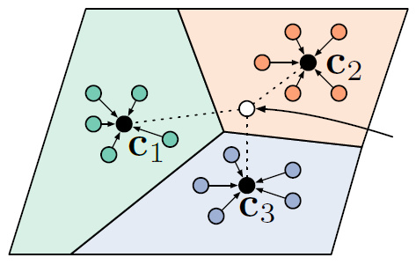





Prototypical Network
Testing
Data
$$s_{1}$$
$$s_{2}$$
$$s_{3}$$
$$s_{4}$$
$$s_{5}$$
CNN
CNN
CNN
CNN
CNN
CNN
= similarity
https://arxiv.org/abs/1703.05175
Notes:
Oriol Vinyals, Charles Blundell, Timothy Lillicrap, Koray Kavukcuoglu, Daan Wierstra, “Matching Networks for One Shot Learning”, NIPS, 2016

Slide 27
Matching Network
Considering the relationship among the training examples
$$s_{1}$$
$$s_{2}$$
$$s_{3}$$
$$s_{4}$$
$$s_{5}$$
CNN
Bidirectional LSTM
= similarity
https://arxiv.org/abs/1606.04080
Notes:
Prototypical Networks for Few-shot Learning
Part of: Advances in Neural Information Processing Systems 30 (NIPS 2017)

Slide 28
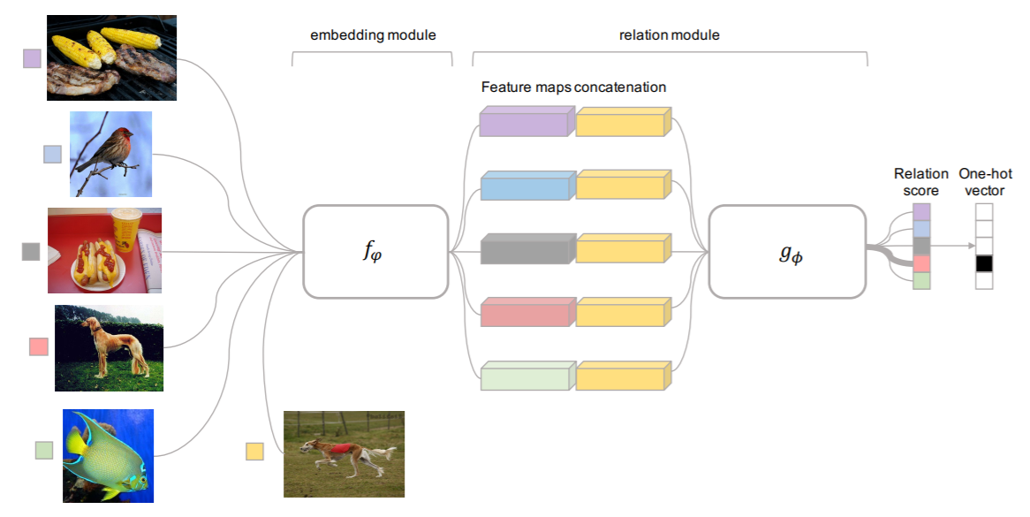
Relation Network
???
https://arxiv.org/abs/1711.06025
Notes:
CVPR 2018
concatenation of feature maps in depth

Slide 29
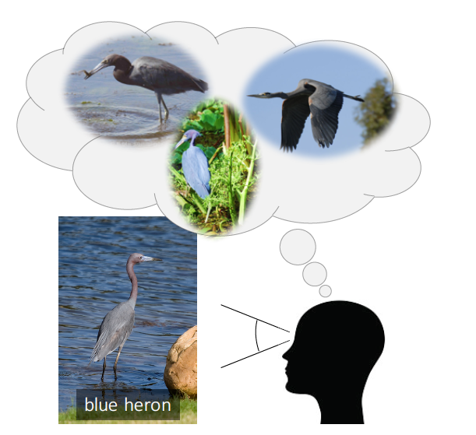
Few-shot learning for imaginary data
https://arxiv.org/abs/1801.05401

Slide 30
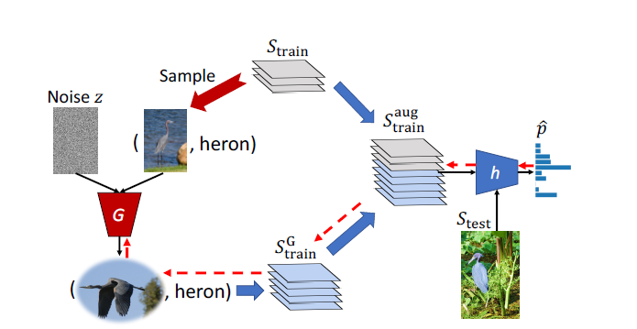
Few-shot learning for imaginary data
https://arxiv.org/abs/1801.05401

